Slide 1
Car Price Prediction
Project Presentation on
Presented By: Sumair Dhir

Slide 2
Table of Content
Overview
Problem Statement
Understanding the Problem
Definition of Car Price Prediction
Why it is Significant?
Exploratory data analysis
Data Visualization
Data Analysis
Data Cleaning
Training and Testing the Models
Hyper Parameter Tunning
Model Saving and using it for Predictions
Conclusion

Slide 3
Overview of the Project
This Presentation focusses on:
Analyzing the Car Price Prediction dataset
Various steps used in EDA for cleaning the dataset
Problem analysis
Building the best model
Finally, Car Price Prediction

Slide 4
Problem Statement
With the covid 19 impact in the market, we have seen lot of changes in the car market. Now some cars are in demand hence making them costly and some are not in demand hence cheaper. One of our clients works with small traders, who sell used cars. With the change in market due to covid 19 impact, our client is facing problems with their previous car price valuation machine learning models. So, they are looking for new machine learning models from new data. We have to make car price valuation model. This project contains two phase
Data Collection Phase: You have to scrape at least 5000 used cars data. You can scrape more data as well, it’s up to you. more the data better the model In this section You need to scrape the data of used cars from websites (Olx, cardekho, Cars24 etc.) You need web scraping for this. You have to fetch data for different locations. The number of columns for data doesn’t have limit, it’s up to you and your creativity. Generally, these columns are Brand, model, variant, manufacturing year, driven kilometers, fuel, number of owners, location and at last target variable Price of the car. Try to include all types of cars in your data for example- SUV, Sedans, Coupe, minivan, Hatchback.
Model Building Phase: After collecting the data, you need to build a machine learning model. Before model building do all data pre-processing steps. Try different models with different hyper parameters and select the best model

Slide 5
Understanding the Problem
Plethora of individuals are interested in the second-hand car market at some point in their life because they want to sell their car or buy a used car. However, its crucial to understand the actual market value of the car before making the buying decision.
This study can help various target groups. For instance, if second-hand car sellers understand what makes a car desirable in a better manner and its important features then they may use this knowledge and offer a better service to the end-user.

Slide 6
Definition of Car Price Prediction
Due to the increased prices of brand-new cars and the financial incapability of the customers to buy them, second-hand Car sales is on an inclination.
Hence, there is an urgent need for second-hand Car Price Prediction system which can effectively determine the worthiness of the car using a variety of features.

Slide 7
Why it is Significant?
The prices of new cars in the industry is fixed by the manufacturer with some additional costs incurred by the Government in the form of taxes. So, customers buying a new car can be assured of the money they invest to be worthy. But due to the increased price of new cars and the incapability of customers to buy new cars due to reasons like lack of funds, used cars sales are on a global increase.
Hence, there is a need for a used car price prediction system to effectively determine the worthiness of the car using a variety of features.
Even though there are websites that offers this service, their prediction method may not be the best.
Besides, different models and systems may contribute in predicting power of second-hand car’s actual market value.
Therefore, it is important to know their actual market value before buying and selling.

Slide 8
Exploratory Data Analysis
Step 1 comprises of scrapping the data from Cardekho.com Website
Step 2 involves importing required libraries and required dataset that was originally in excel format
Step 3 comprises of checking the shape, nunique, value counts, info etc., collectively known as statistical analysis of data
In Step 4 null values were found and hence replaced using imputation technique
Step 5 involves dropping Unnamed:0, cargo_volume and Insp_score column as they were insignificant
Finally, data types of all the columns were converted and useful information was extracted from the raw dataset.

Slide 9

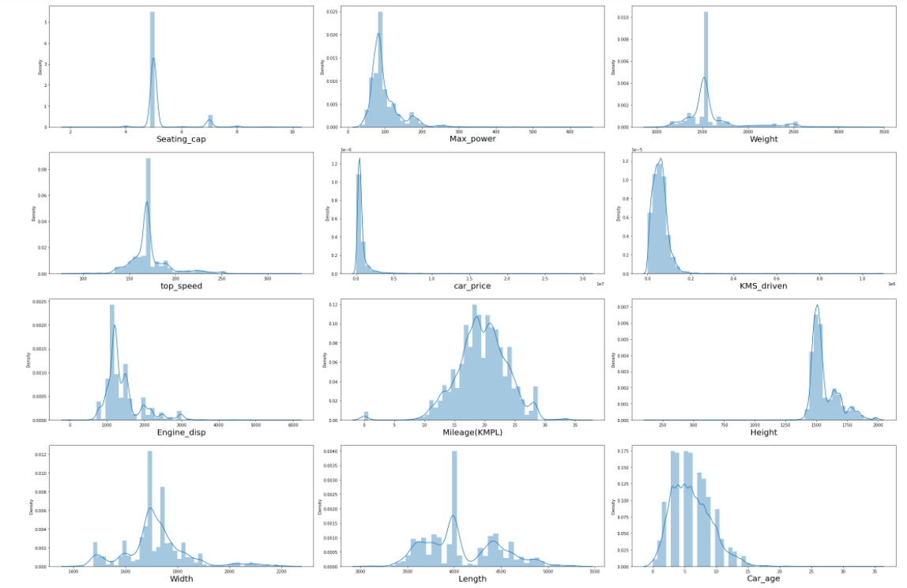
Univariate Visualization of numerical columns

Slide 10
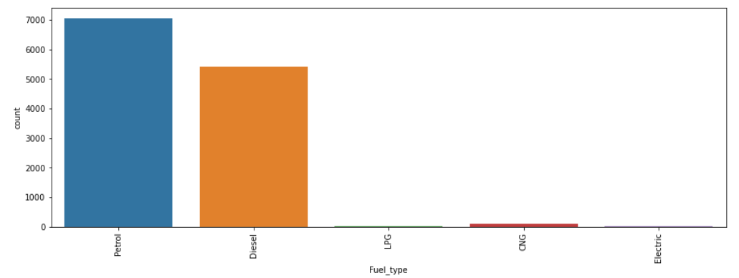
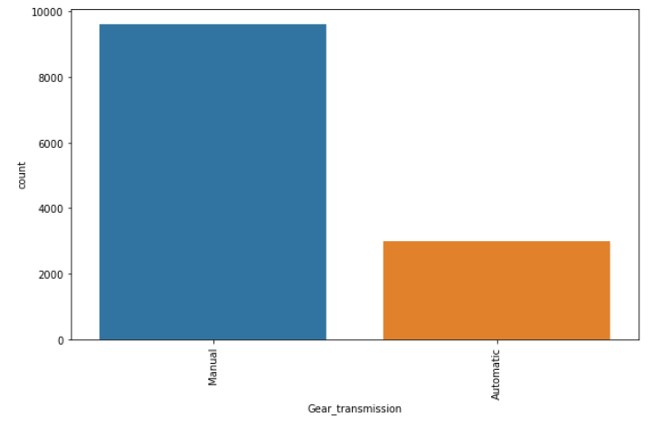
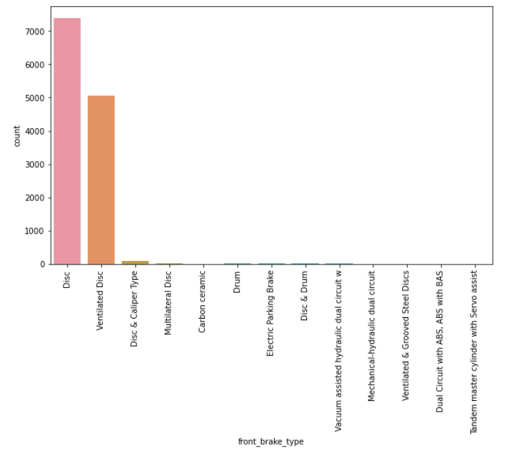
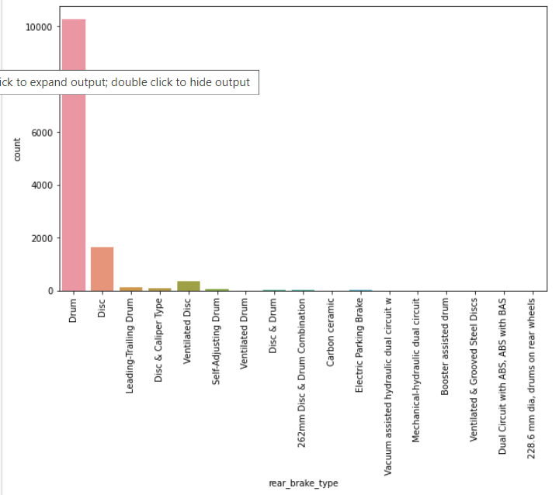
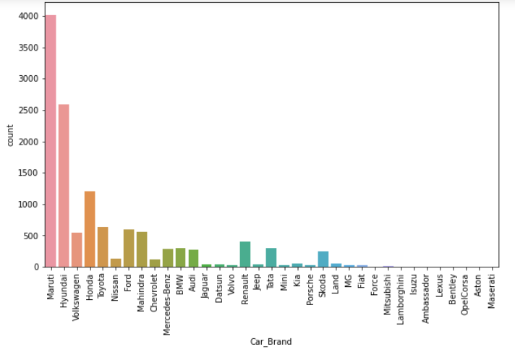
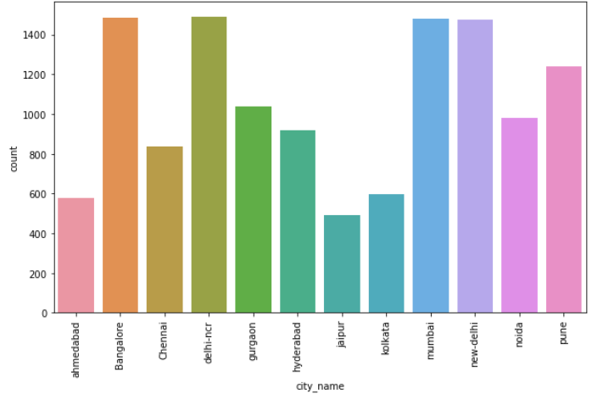
Univariate Vizualization of Categorical columns

Slide 11
Observations
Univariate numerical columns:
It can be identified that there is skewness in most of the columns, hence there is a need to treat them using suitable methods.
Univariate categorical columns:
Maximum cars are petrol driven and diesel driven.
Maximum cars are with Manual gear transmission.
Disc front brake cars are more in number followed by Ventilated Disc.
Drum rare break cars are more in number.
Maximum cars under sale are Maruti followed by Hyundai.
In Bangalore, Delhi-Ncr, Mumbai and New-delhi we can find maximum cars for sale. Since these are most populated places.

Slide 12
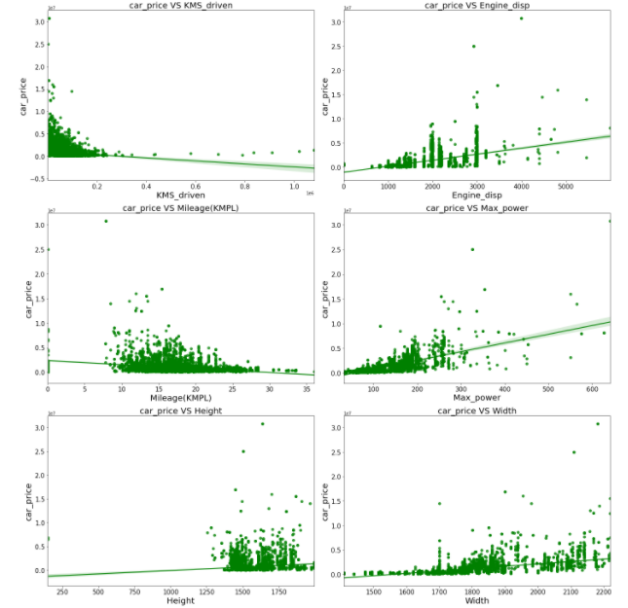
Bivariate Vizualization of numerical columns:

Slide 13
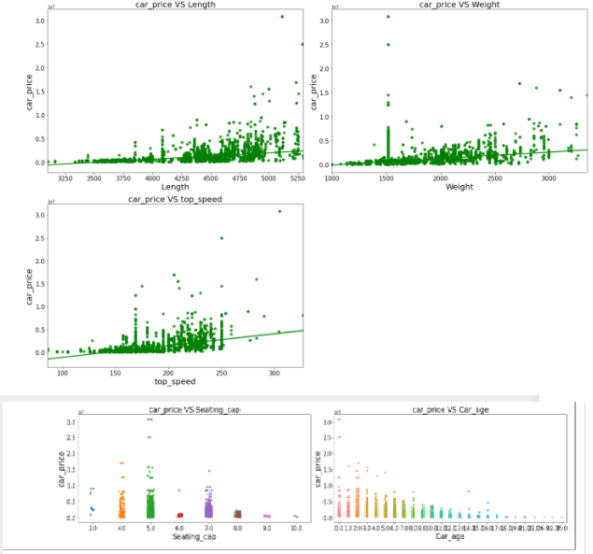
Bivariate Vizualization of numerical columns:

Slide 14
Observations
Most of the cars are less than 20k driven kms and car price is high for less driven cars.
Maximum cars have 1000-3000 Engine_disp. and car price is high for 3000 Engine_disp.
Majority of cars have mileage of 10-25 kms however, it has no proper relation with car price.
As Max_power is increasing car price is also increasing.
Car_price has no proper relation with height.
As the width is increasing car price is also increasing.
As length is increasing car price is also increasing.
Weight also has linear relationship with car price.
As top_speed is increasing car price is also increasing.
Cars with 4 and 5 seats are having highest price.
As the age of the car increases the car price decreases.

Slide 15
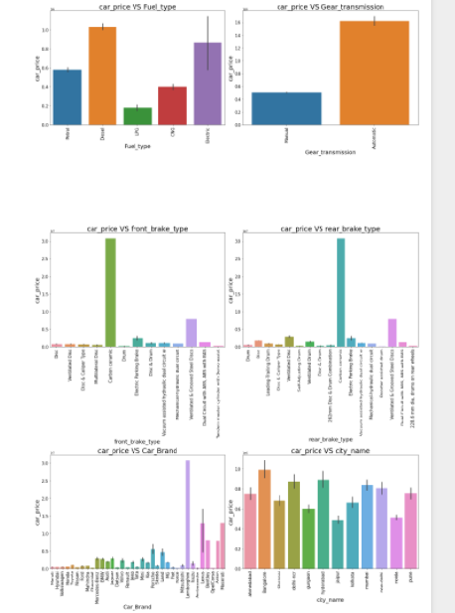
Bivariate Vizualization of categorical columns:

Slide 16
Observations
Diesel and Electric cars have high price compared to Petrol, LPG and CNG.
Automatic gear cars are costlier than manual gear cars.
Cars having carbon ceramic front break are costlier compared to other cars.
Cars having carbon Ceramic rear break are costlier compared to other cars.
Lamborghini brand cars are having highest sale price.
In Bangalore, Hyderabad and Delhi-Ncr, the car prices are high as they are highly populated cities.

Slide 17
Data Analysis
Dist plot is used to check the skewness in numerical columns.
Bar plot is used for each categorical feature that shows the relation with the median car price for all the sub-categories in each categorical feature.
Also, for continuous numerical variables, reg plot and strip has been used to show the relationship between continuous numerical variable and target variable.
It has been identified that there is a linear relationship between continuous numerical variable and Car Price.

Slide 18
Data Cleaning
Data scrapping was done from cardekho.com website and saved in excel format.
Dataset was having null values, outliers and skewness.
Null values were replaced using imputation method. Outliers were removed using Z-score method. And to remove skewness, power transformer method was used.
Encoding was done for the categorical columns using Label Encoder.
R2_Score was used to check the correlation between dependent and independent features.
Data was then standardized. Then followed by model building with all regression algorithms.

Slide 19
Training and Testing the Models
Since Car Price was my target and it was a continuous column so this perticular problem was regression problem. And I have used all regression algorithms to build my model. By looking into the difference of r2 score and cross validation score I found DecisionTreeRegressor as a best model with least difference. Also to get the best model we have to run through multiple models and to avoid the confusion of overfitting we have go through cross validation. Below are the list of regression algorithms I have used in my project.
RandomForestRegressor
XGBRegressor
GradientBoostingRegressor
KNN Regressor
DecisionTreeRegressor
Linear Regression
SVR

Slide 20
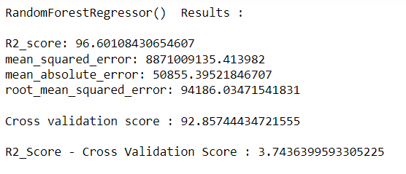
i) RandomForestRegressor
RandomForestRegressor has given me 96.60% r2_score and the difference between r2_score and cross validation score is 3.74%.

Slide 21
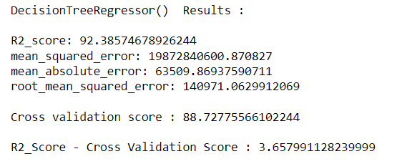
ii) Decision Tree Regressor
Decision Tree Regressor shows 92.38% r2_score and the difference between r2_score and cross validation score is 3.65%.

Slide 22
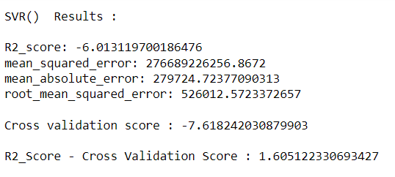
iii) SVR Regressor
SVR Regressor shows -6.01% r2_score and the difference between r2_score and cross validation score is 1.6%.

Slide 23
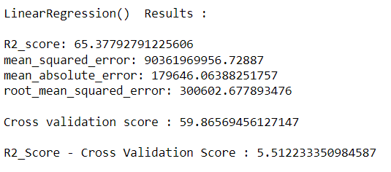
iv) Linear Regression
Linear Regression gives 65.37% r2_score and the difference between r2_score and cross validation score is 5.5%.

Slide 24
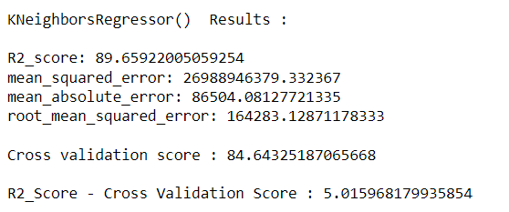
v) KNN Regressor
KNN Regressor is giving 89.65% r2_score and the difference between r2_score and cross validation score is 5.01%.

Slide 25
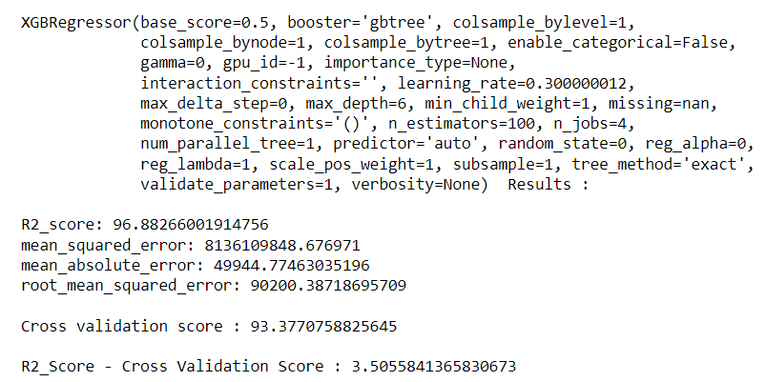
vi) XGB Regressor
XGB Regressor is giving 96.88% r2_score and the difference between r2_score and cross validation score is 3.50%.

Slide 26
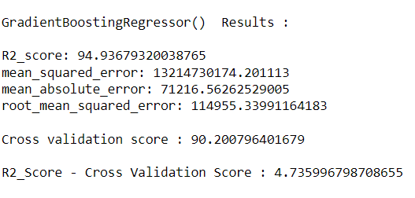
vi) Gradient Boosting Regressor
Gradient Boosting Regressor is giving 94.93% r2_score and the difference between r2_score and cross validation score is 4.73%.

Slide 27
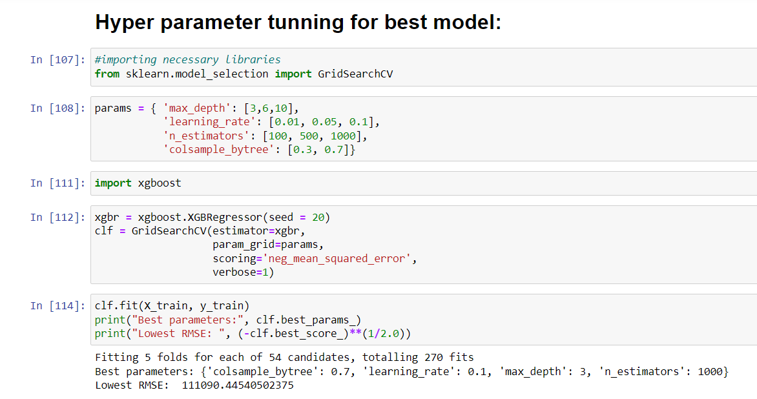
Hyper Parameter Tuning

Slide 28
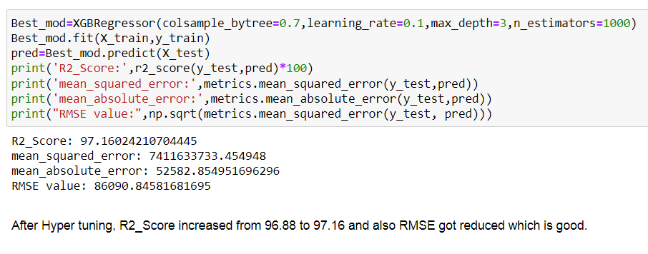
Hyper Parameter Tunning
After tunning the model with best parameters, I was able to increase my model accuracy from 96.88% to 97.16%.

Slide 29
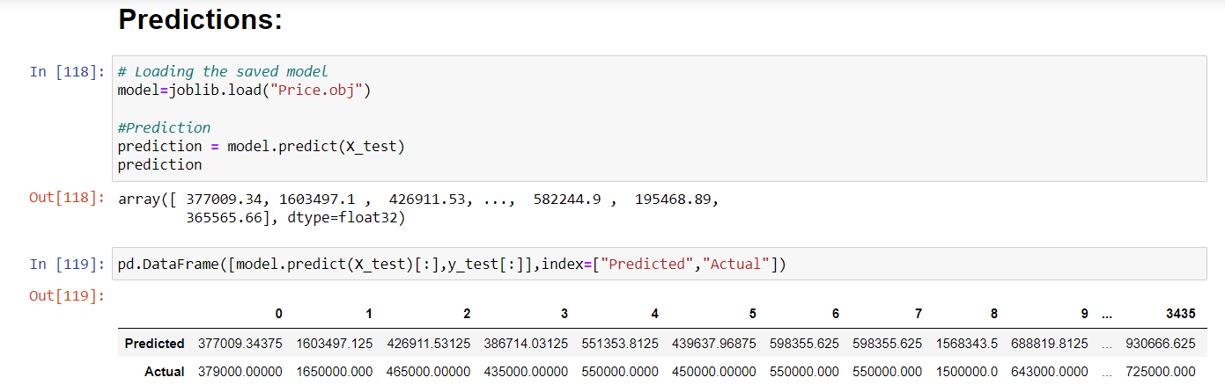
Model saving and using it for predictions
I have predicted the Car Price using saved model, and the predictions look good. The Predicted values are almost same as actual values.

Slide 30
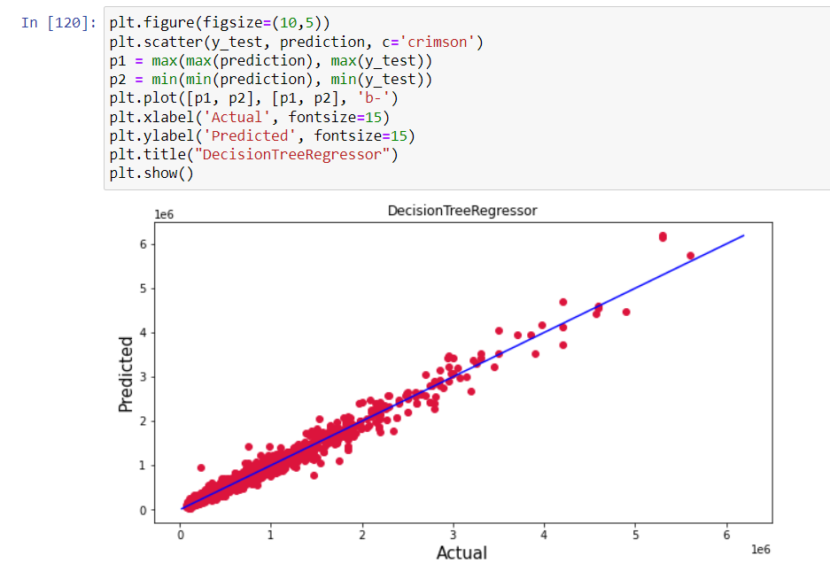
Ploting the predicted values v/s actual values
Plotting Actual vs Predicted to get better insight. Blue line is the actual line and red dots are the predicted values

Slide 31
Conclusion
In this project report, I have used Machine learning algorithms to predict the second-hand car price. I have mentioned the step-by-step procedure to analyse the dataset and finding the correlation between the independent variables and target variable.
Hence, the features which are correlated to each other and are independent in nature are selected. With the help of visualization and its graphical representation, I was able to understand what data is trying to say.
Data cleaning is one of the most important steps to remove unrealistic and unnecessary values.
The data was done divided into training and testing set which were then given as an input to various algorithms and then, the best model was selected, and hyper parameter tunning was done in order to improve its accuracy. Hence, we calculated the performance of each model using different performance metrics and compared them based on these metrics.
Finally, the best model was saved, and the car price was predicted. And the predicted and actual values were almost same.
To conclude, the application of machine learning in car price prediction is still at an early stage. I hope this study has moved a small step ahead in providing some methodological and empirical contributions to online platforms and presenting an alternative approach to the valuation of second-hand car price.
In the future, research may consider incorporating additional second-hand car data from a larger economical background with more features.

Slide 32
THANK YOU

